Slide 1
Optoelectronics (Training) Lab/OE Lab

Slide 2
I. Biophotonics

Slide 3
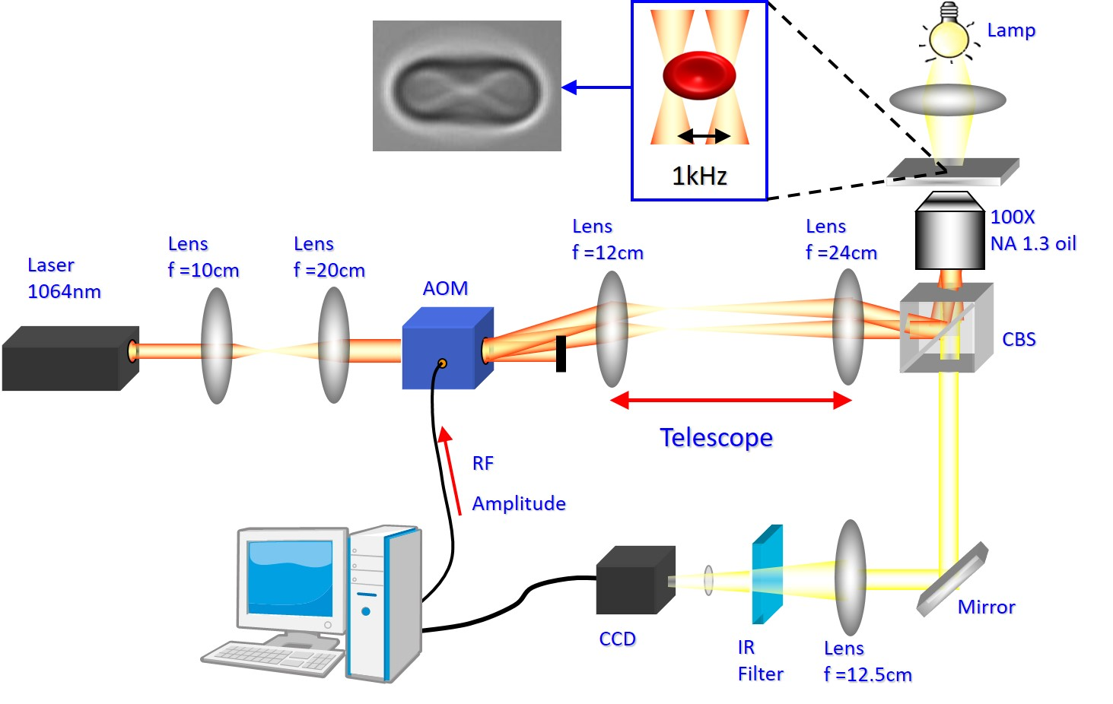
Jumping Optical Tweezers
Liao et al., Optics Express, vol.16, 1996-2004, 2008
Liao et al., J. Biophotonics, vol.7, No.10, 2014

Slide 4
Optical Stretch-Induced Calcium Influx -Stretch Activated Ion Channel

Slide 5
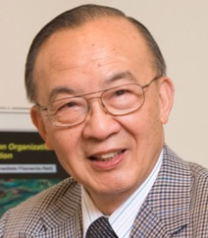

Slide 7
II. Imaging

Slide 8

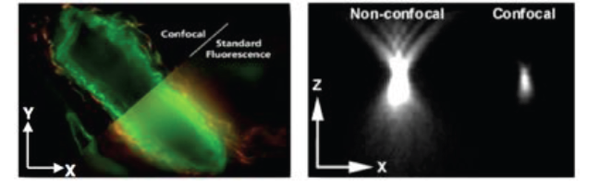
Point Spread Function (PSF) and Convolution Image
http://zeiss-campus.magnet.fsu.edu/articles/superresolution/introduction.html

Slide 9
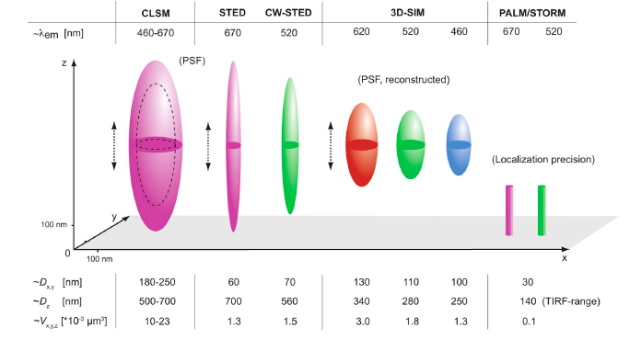
Point Spread Function Table

Slide 10
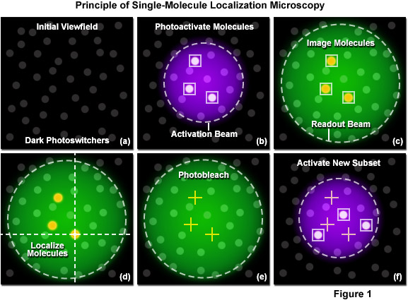
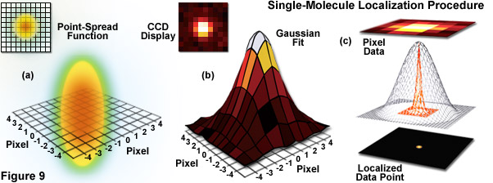
Photon-switch and Localization of Single Molecular
http://zeiss-campus.magnet.fsu.edu/articles/superresolution/introduction.html

Slide 11
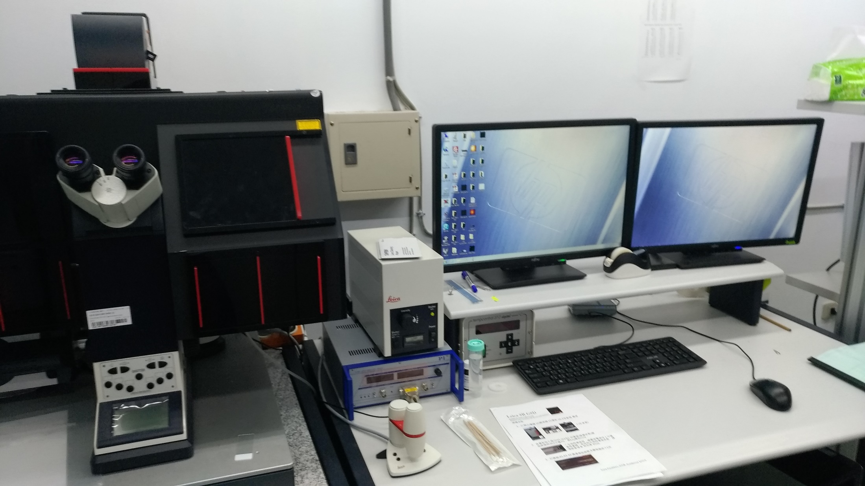

Slide 12
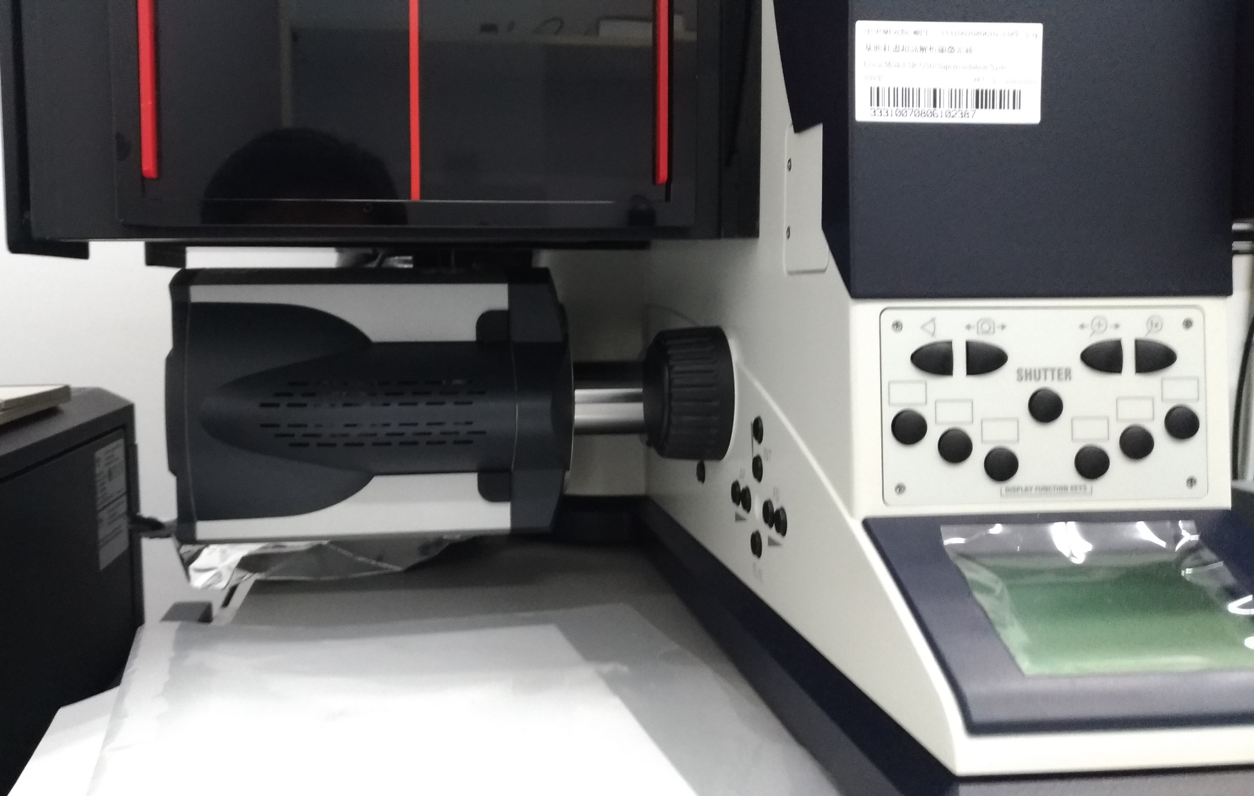

Slide 13
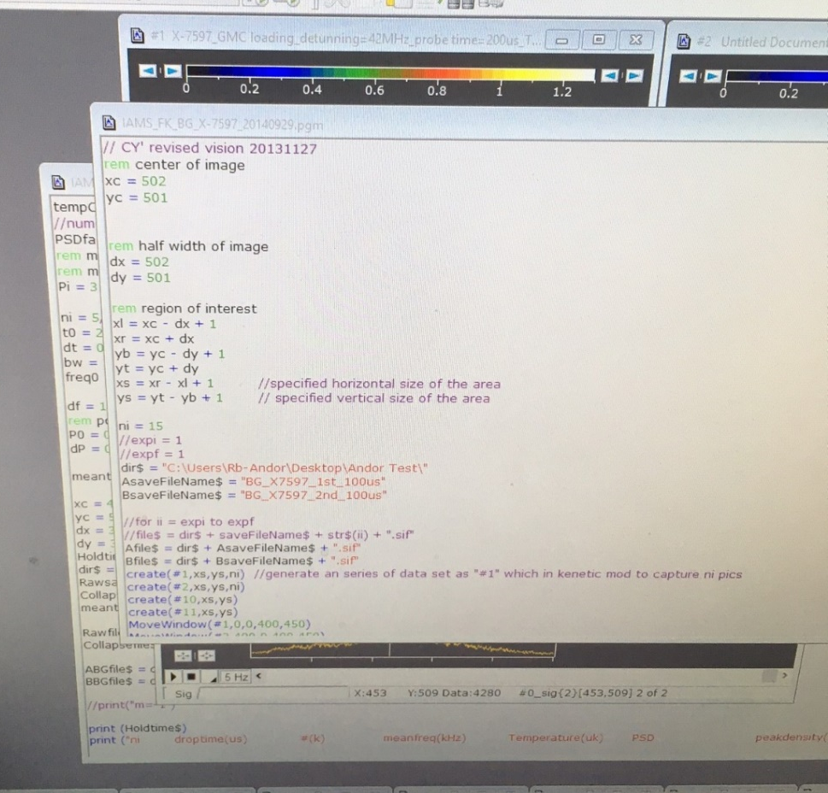
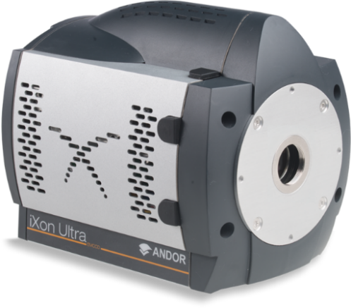
Single-photon Sensitive EMCCD
Andor ixon 888
Andor Basic

Slide 14
III. Lasers

Slide 15
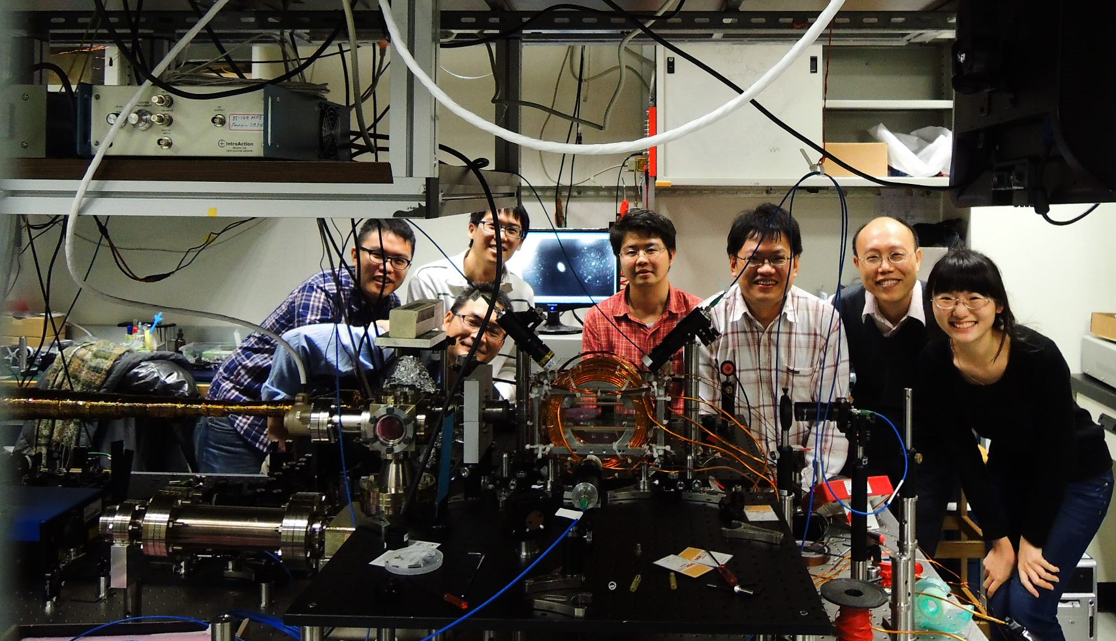
Atomic, Molecular, and Optical Physics (AMO)
2012.12.12 First K MOT

Slide 16
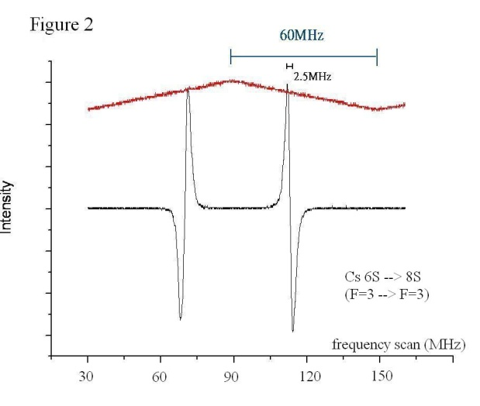
OSA/autocorelator
to User (DFCS)
200 mW (comb)
δ-stabilization
KLMLL
grating
40 mW (comb)
Δ-stabilization
Cs-Stabilized 822.5 nm ECDL #2
GPS
7 mW (diode)
Fiber
AOM
Allan Variance checking
ECDL #1
TA
DPA
Cs 6S → 8S 822.5 nm two-photon transitions
Off lock
PZT lock
PZT
AT
GPS
FB
Cs 6S→ 8S
F=3→ F=3
AOM lock

Slide 17
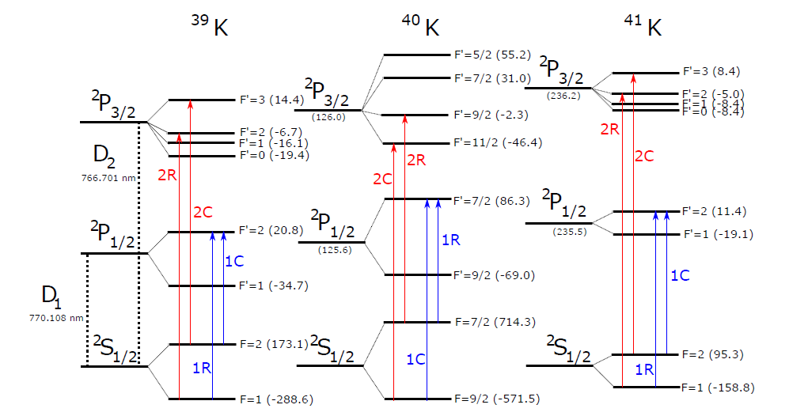
93%
0.01%
7%
Ref: M. Tarnowski, Thesis (2015).

Slide 18
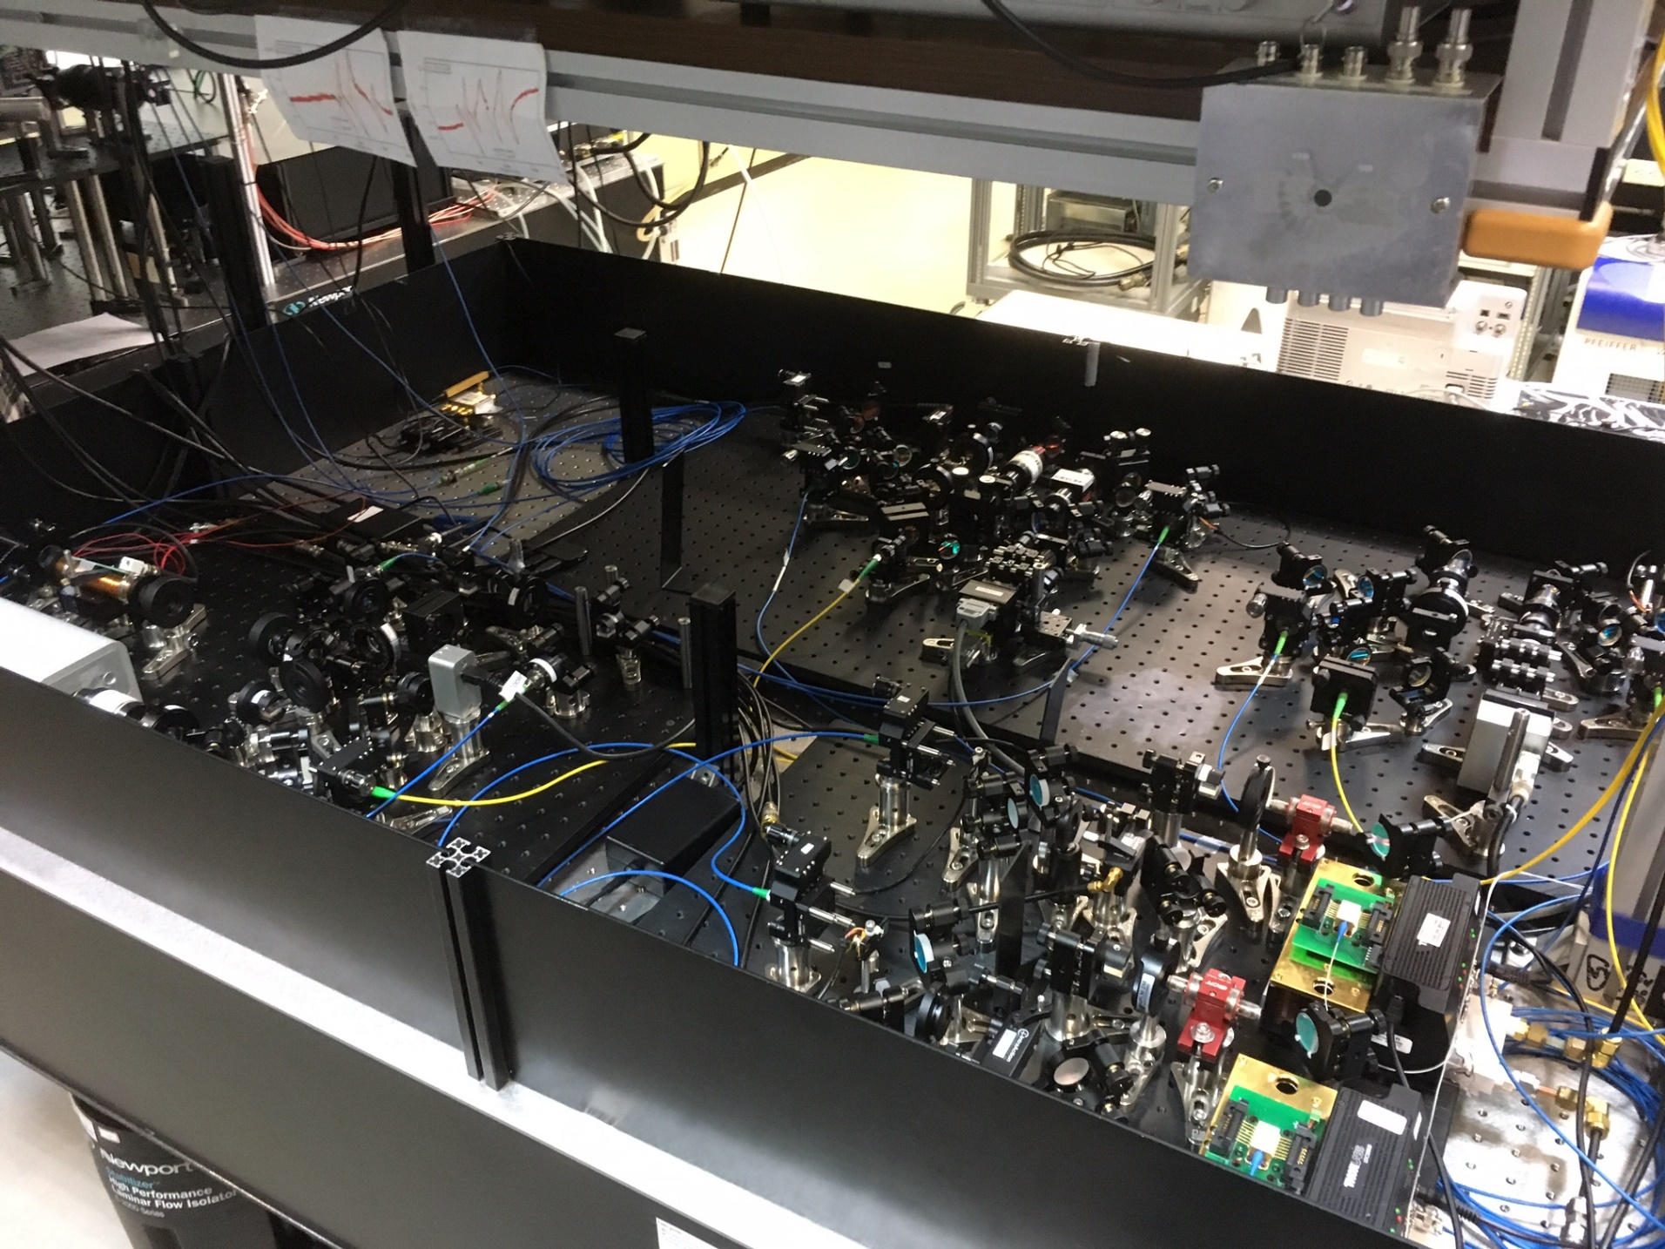

Slide 19
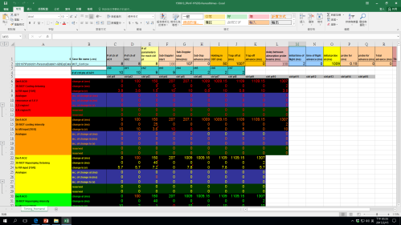
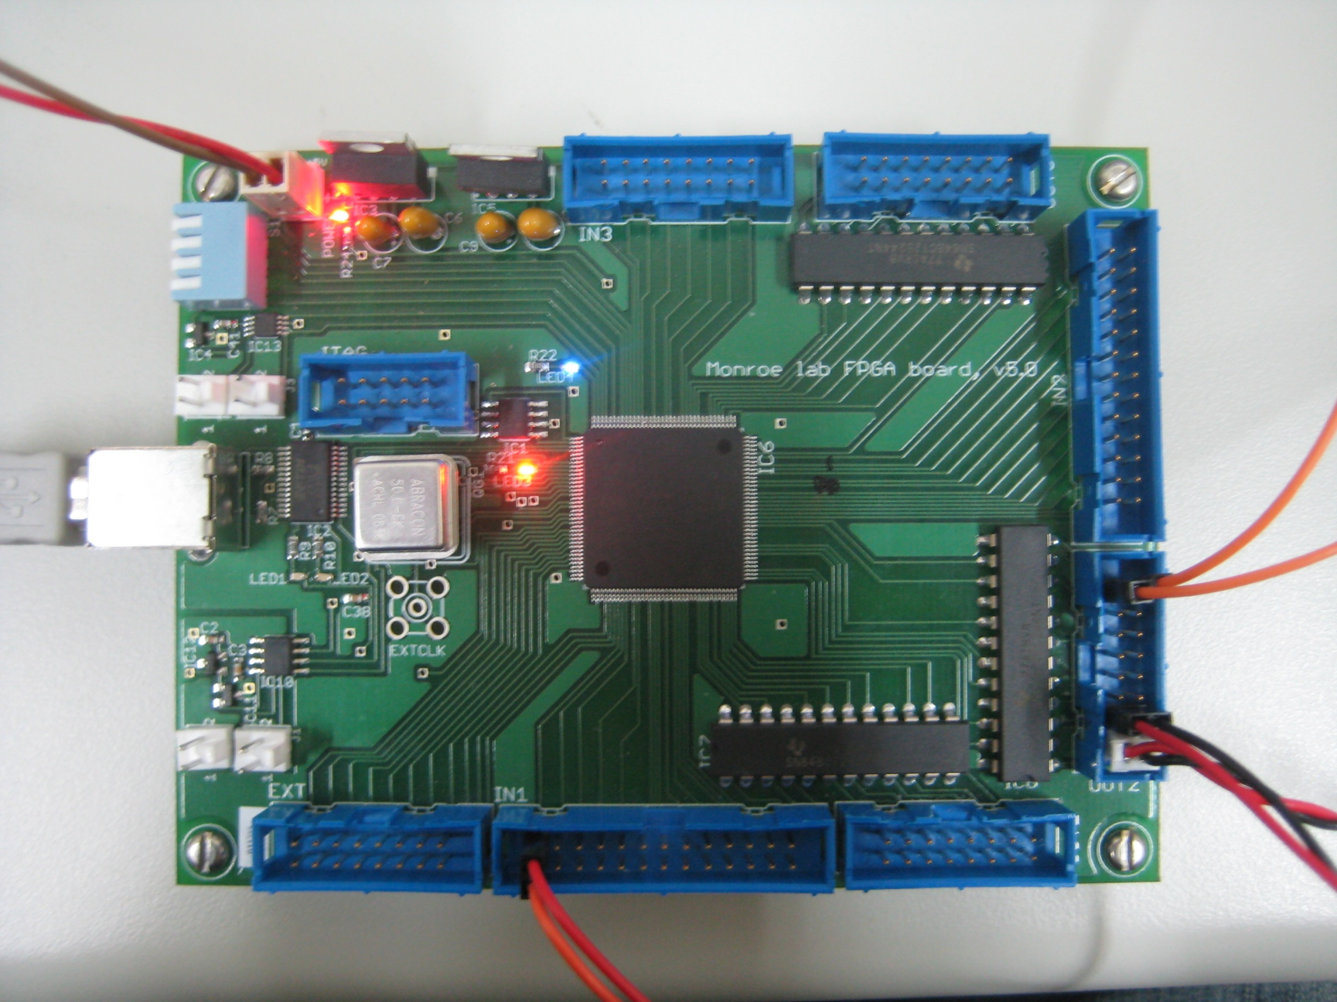
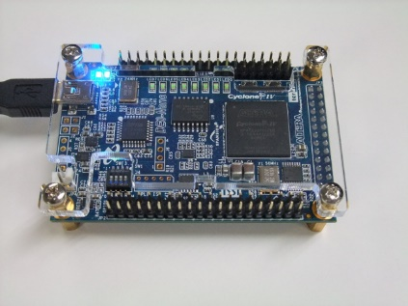
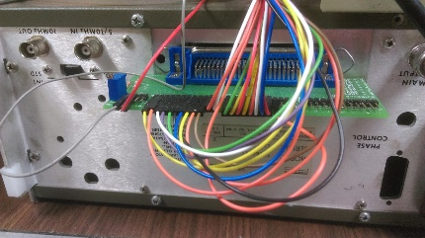
Timing Data
Analogue Output
Digital Output
FPGA1
FPGA2
NI PCI-6713
Synchronize
External Trigger
Synchronize
20 kHz TTL
NI PCI-6713
010000110….
DE0Nano
Laser Frequency
Laser Intensity
Magnetic Field
Camera Triggers
Mechanical Shutter
Digital Shutter
…..
…..
PTS-500
1~500Mhz
Spin State Control

Slide 20
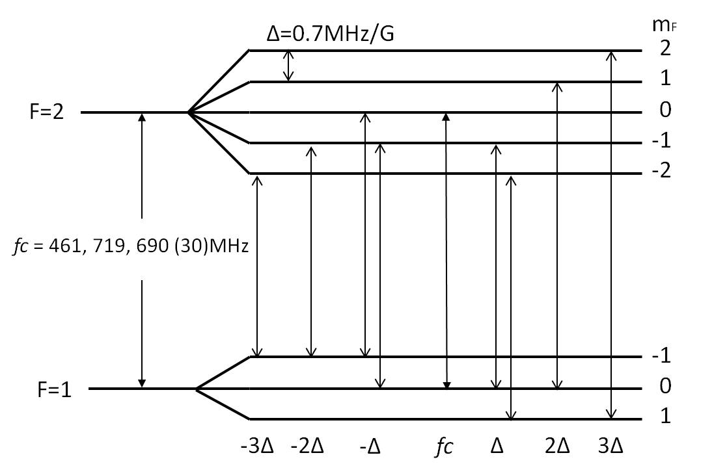
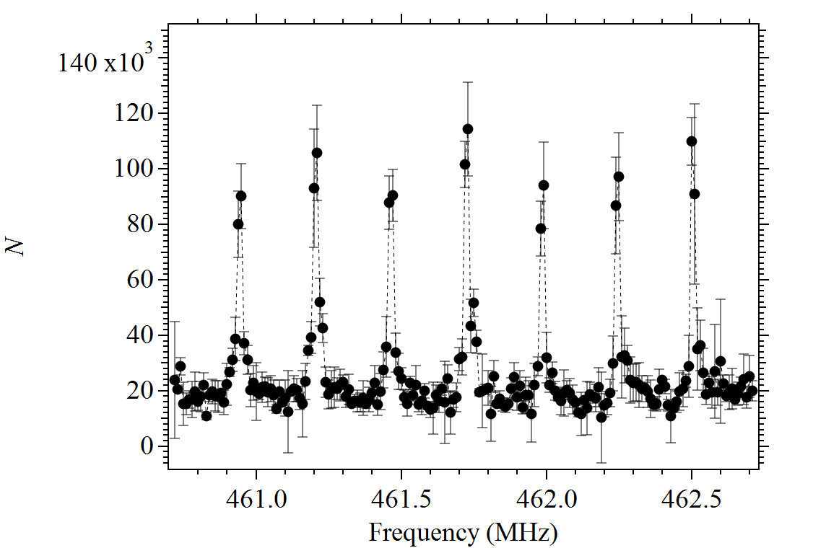
Spin population control by radio frequency (RF)

Slide 22
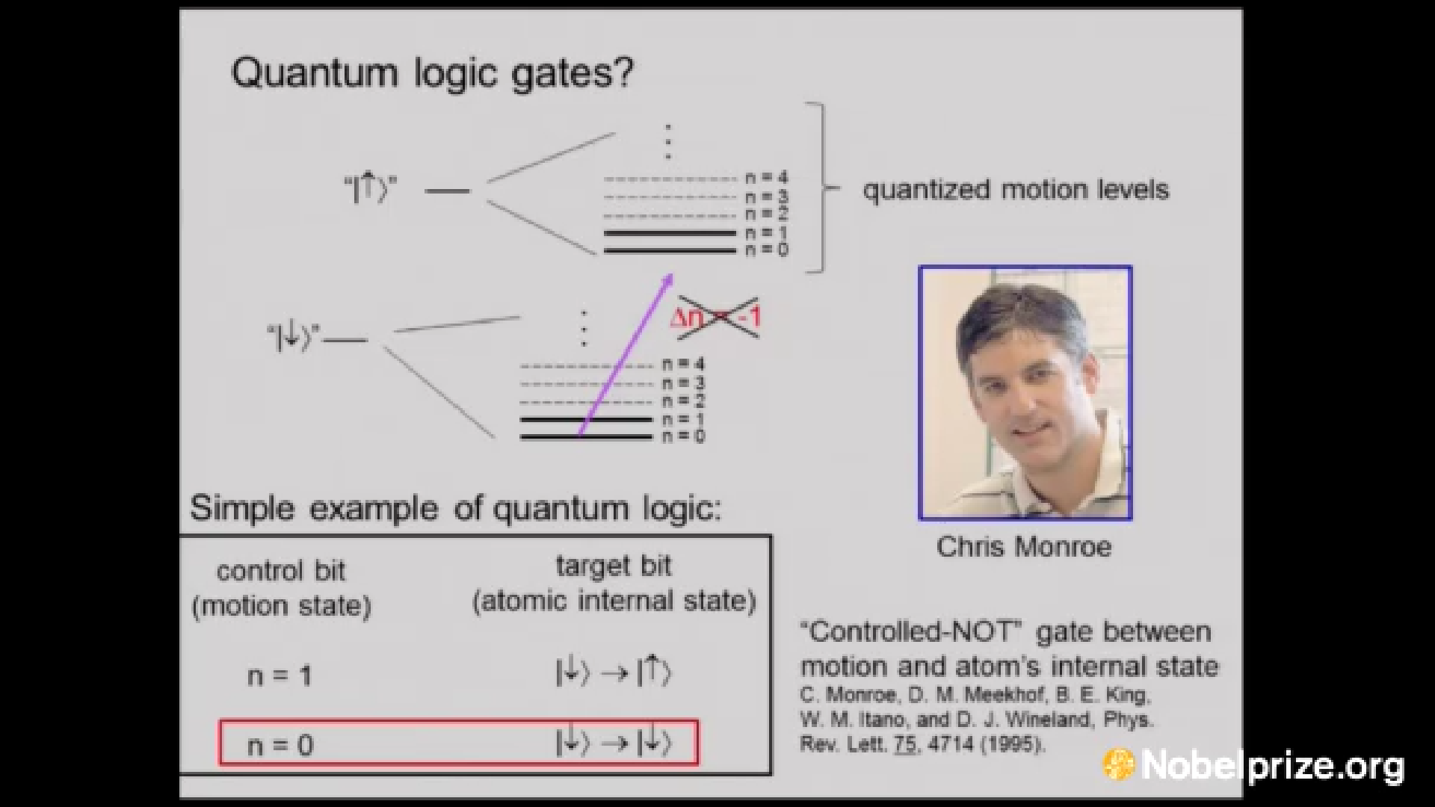

Slide 23
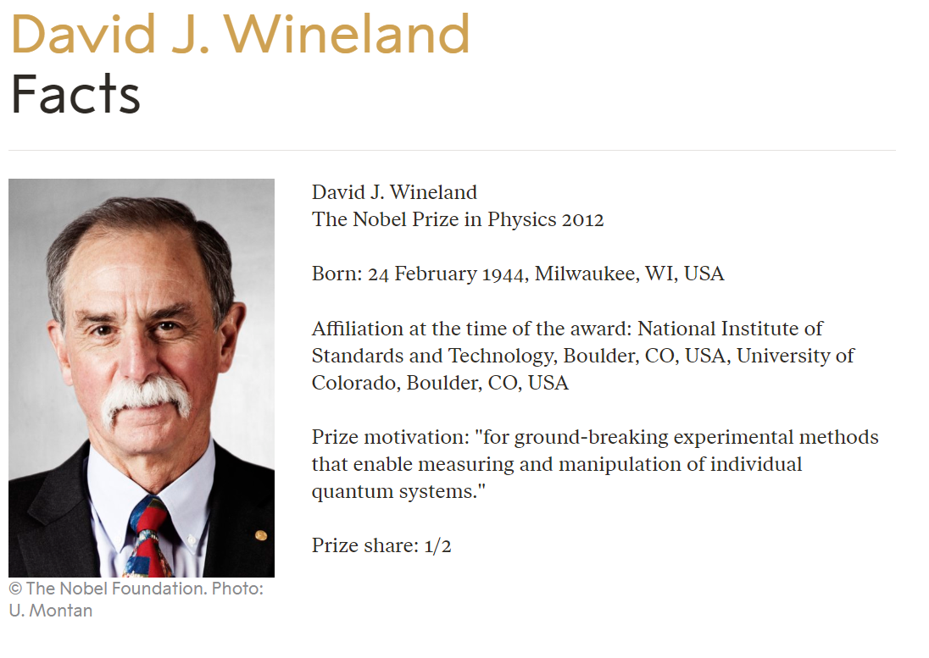
Ion Trap + Laser Cooling

Slide 24

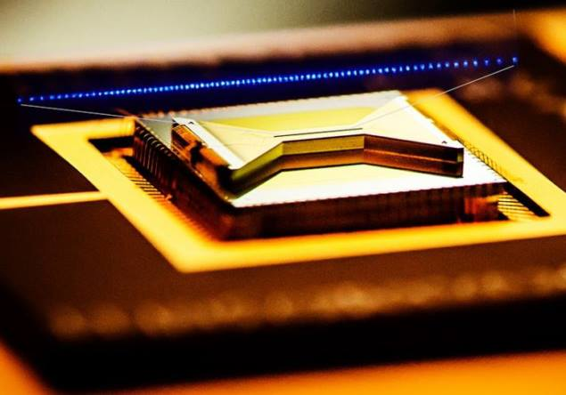


Quantum Computing Startup

Slide 25
~ Thanks

Slide 28
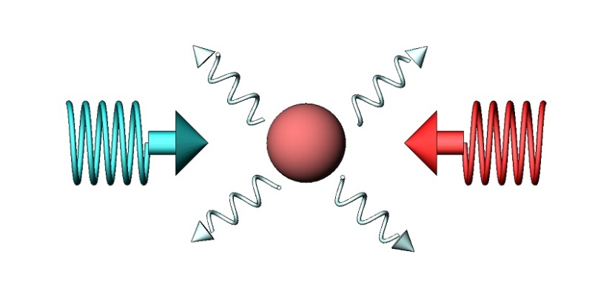
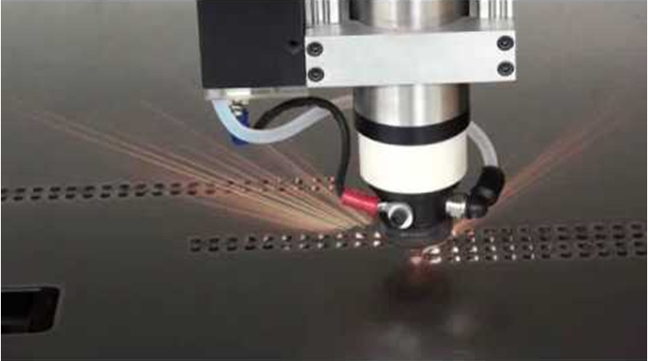
Laser Heating V.S Laser Cooling
Peter Pringsheim, Lev D. Landau (1929)
A. Schawlow, T. W. Hansch (1975)

Slide 29
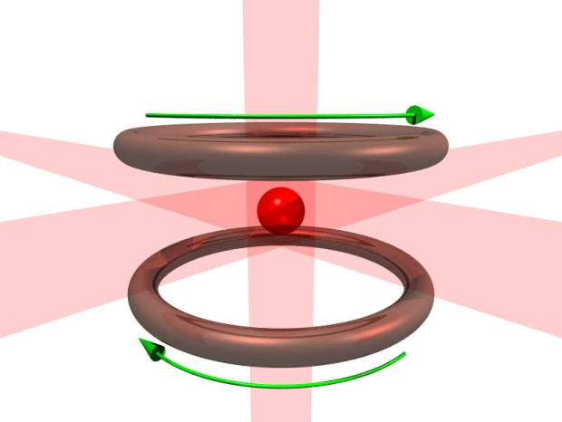
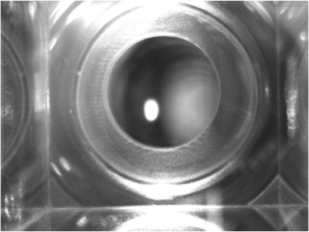
Magneto-Optical Trap
σ⁻
m_{j}
m_{j}
σ⁺
σ⁻
-1
E
1
J = 1
0
Δ
0
1
-1
σ⁺
σ⁻
σ ⁺
ω_{l}
σ ⁻
σ⁺
J = 0
J = 0
z
Magneto-Optical trap
(MOT, the bright spot)
Notes:
這兩張圖片是簡單的MOT和Dipole trap 的示意圖 左邊這張圖是MOT,中間這個小白點就是被磁光井限至住的 cold atom 右邊就是把cold atom 在進一步 load 到dipole trap 裡 ，我們大部分的實驗都是從把原子load到Dipole 開始

Slide 30
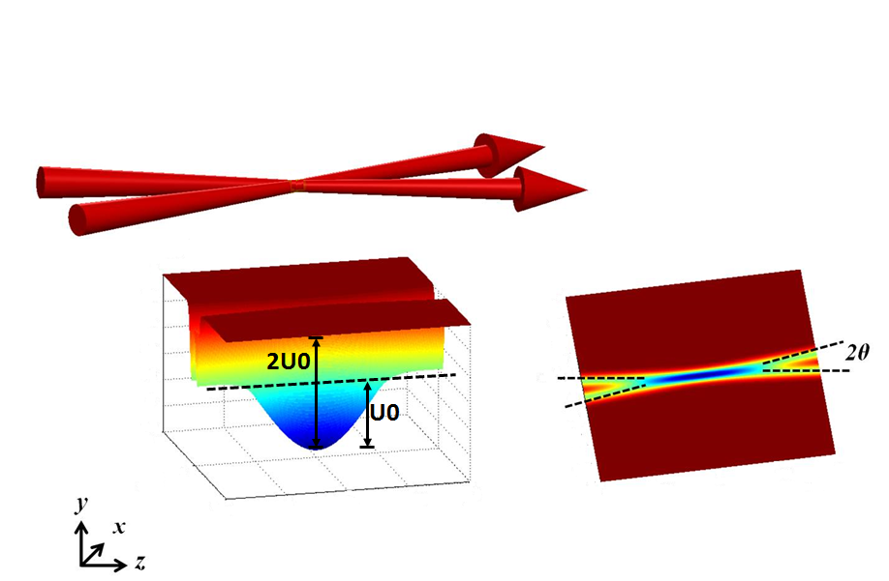
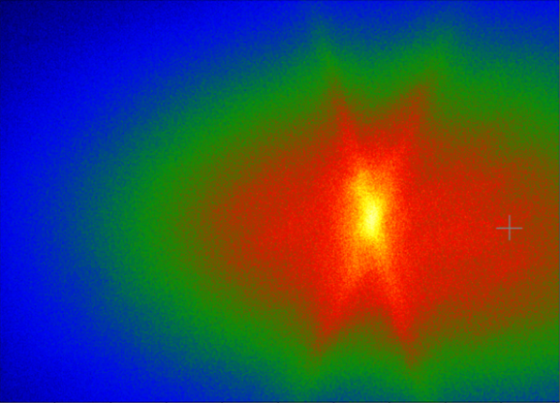
Our experimental approach
σ⁻
σ⁺
σ⁻
σ⁺
σ⁻
σ⁺
Liao et al., JOSA B (2017)
Sub-Doppler Cooling
CMOT, n > 10¹⁰ cm⁻³
TDMOT, T ~ 50 μK
GMS, T ~ 10 μK
Magneto-Optical trap
(MOT, the bright spot)
Optical dipole trap
(ODT, overlapped with MOT)
Notes:
這兩張圖片是簡單的MOT和Dipole trap 的示意圖 左邊這張圖是MOT,中間這個小白點就是被磁光井限至住的 cold atom 右邊就是把cold atom 在進一步 load 到dipole trap 裡 ，我們大部分的實驗都是從把原子load到Dipole 開始

Slide 31
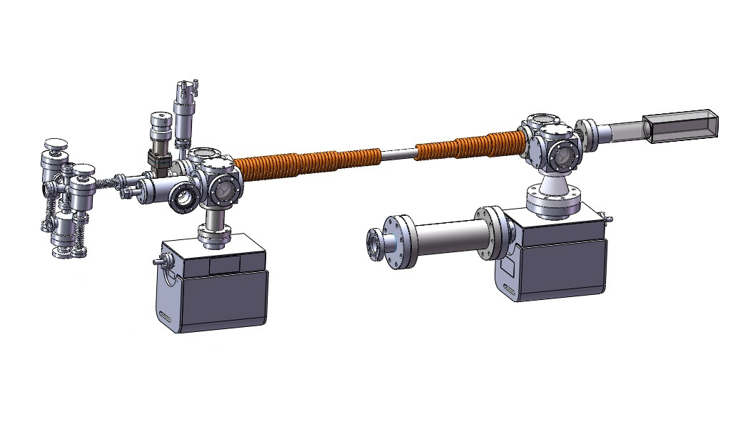
Vacuum System
~ 6*10⁻¹² torr
(1-1)
(1-2)
(2)
(3)
(1-3)
(4)
(5)
Potassium gas
Trapping all spin states:
³⁹K,⁴¹K(Spin-1 boson)
⁴⁰K(Spin-9/2 fermion)
(1-1) Rb Ampule
(1-2) K Ampule
(1-3) Valve
(2) Zeeman Slower
(3) Science Cell
(4) Titanium Sublimation Pump
(5) Ion Pump

Slide 32
How Sharp of Your Lasers
Resolution
Laser Spectroscopy cm⁻¹ (~30 GHz) Chemical Analysis
High Resolution GHz Lamb Shift
Laser Spectroscopy Four-Wave Mixing
Ultra-high Resolution < MHz Laser Cooling
Laser Spectroscopy Hyperfine Structure
Length Standard

Slide 33
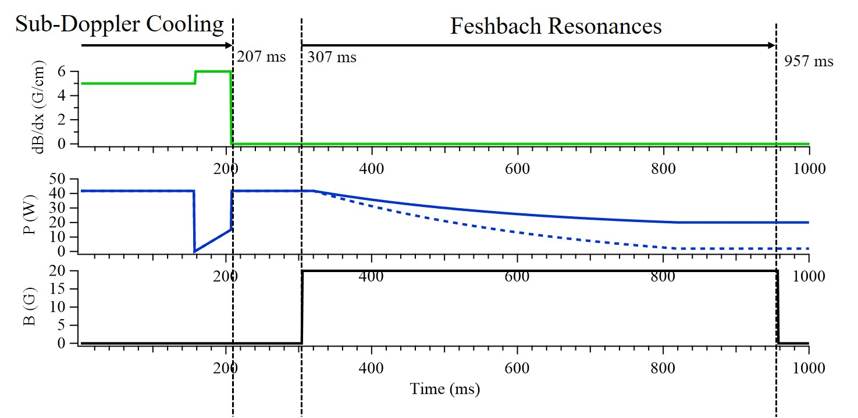

Slide 34
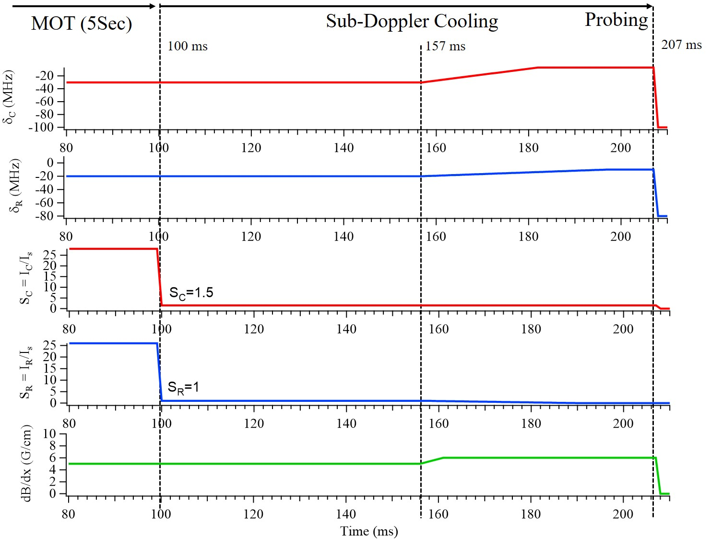

Slide 35
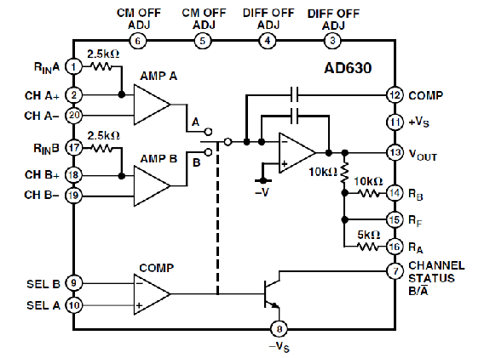
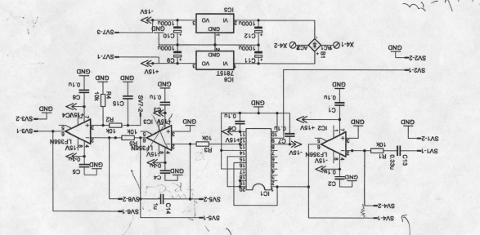
Simple Lock-in Amplifier
AD630
10k
10k
Low-Pass Filter
100k
output
0.1u
GND

Slide 36
